Slide 1
World Happiness Report Dataset
Data Visualization and Prediction
CZ1015 INTRO TO DATA SCIENCE
MINI-PROJECT PRESENTATION
DONE BY: XIAO YANG
WONG CHUN FOONG
KEANE NGUYEN KIM XUYEN

Slide 2
First, let’s look into our…
Background
What will be the
World’s Happiness Score in the next 5 years?
DATASET
CHOSEN
CLEAN
DATASET
UNDERSTAND
DATASET
First, we choose the 2019 WHR dataset
Next, we prepare the dataset by filling N.A.s with 0s and mapping regions and country codes to respective country
Then, we use the data to visualize and predict the data to answer our above question
Visualization
Analysis
Prediction
Outcome
Conclusion

Slide 3
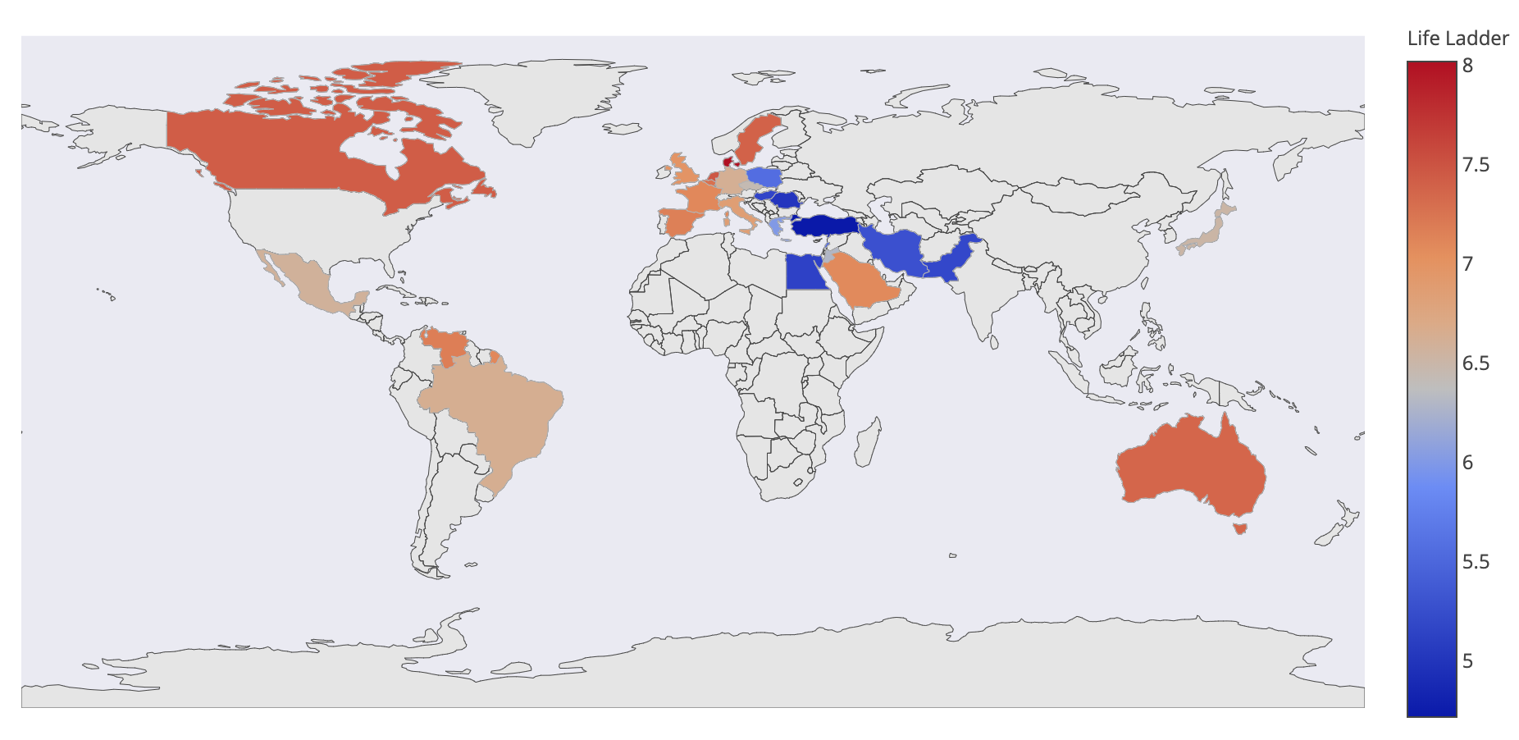
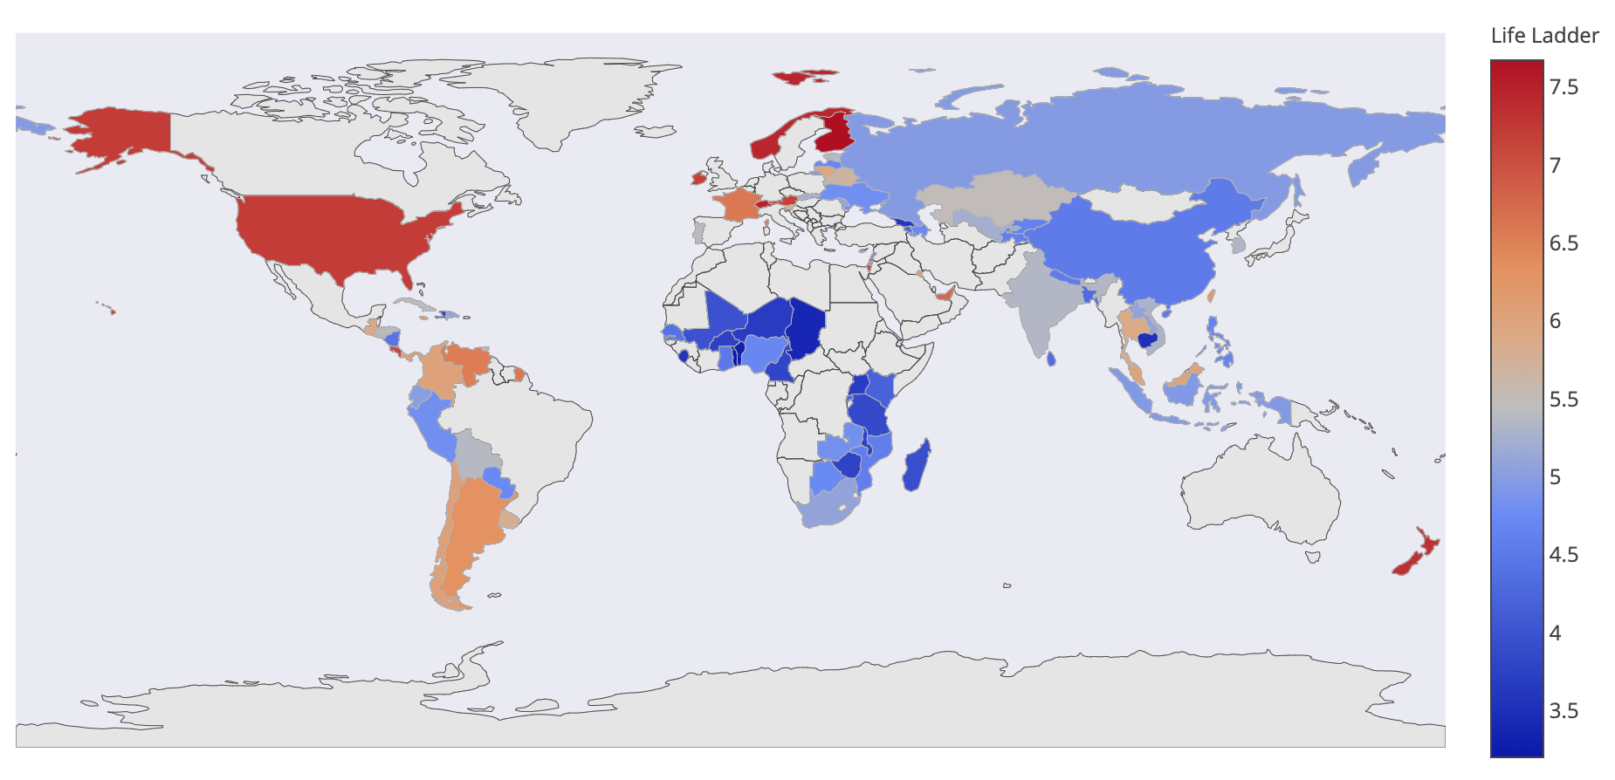
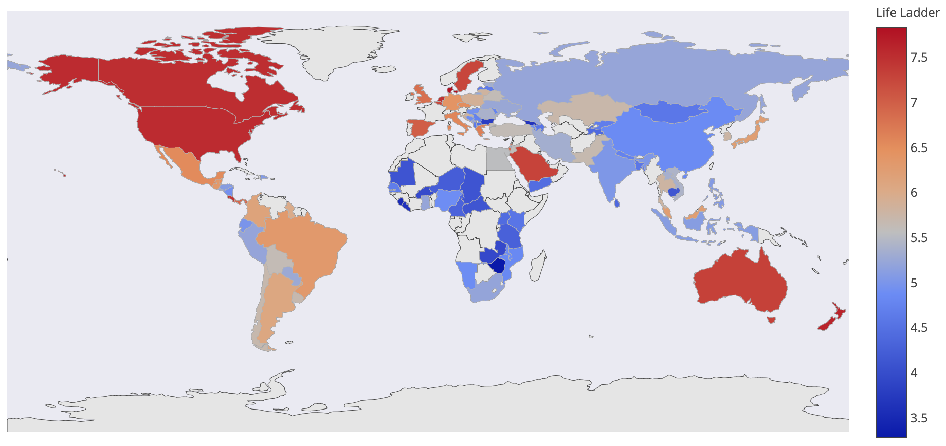
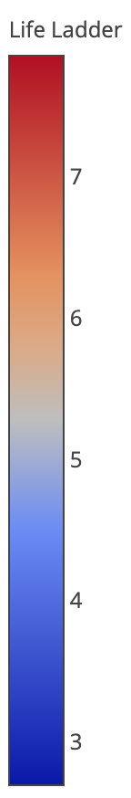
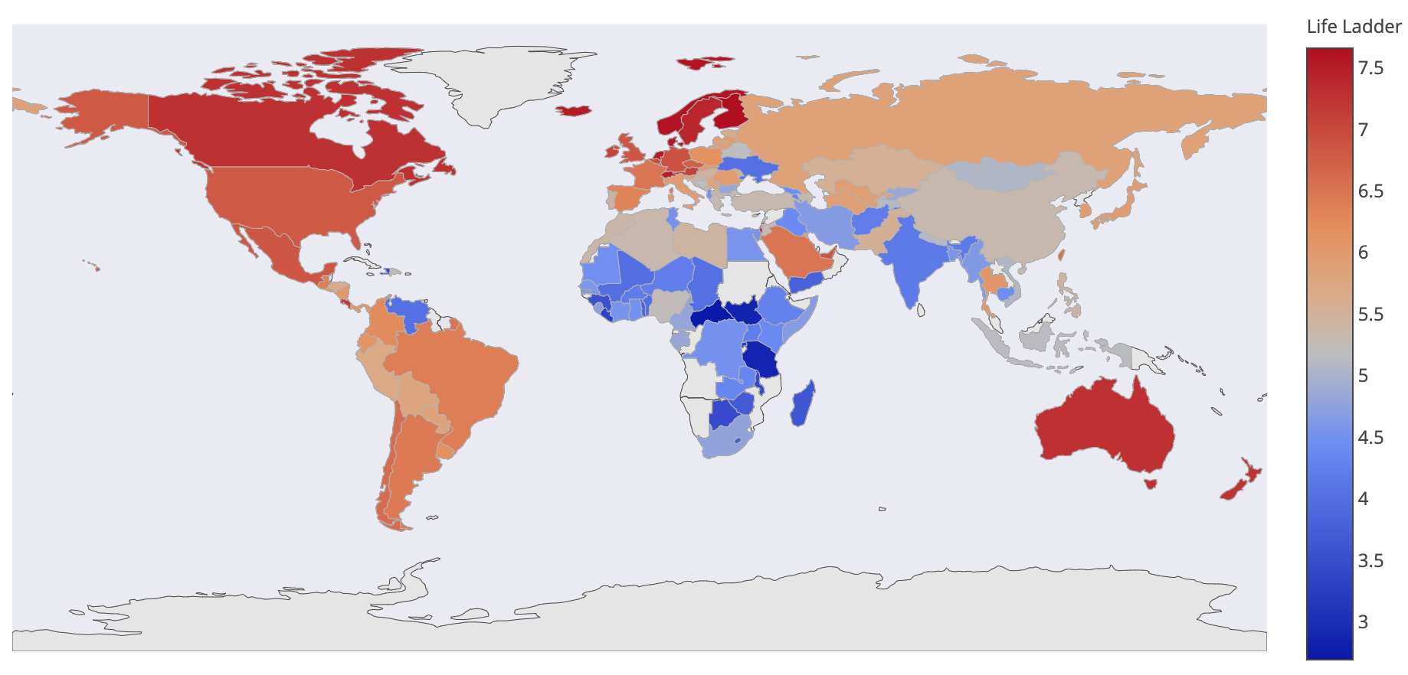
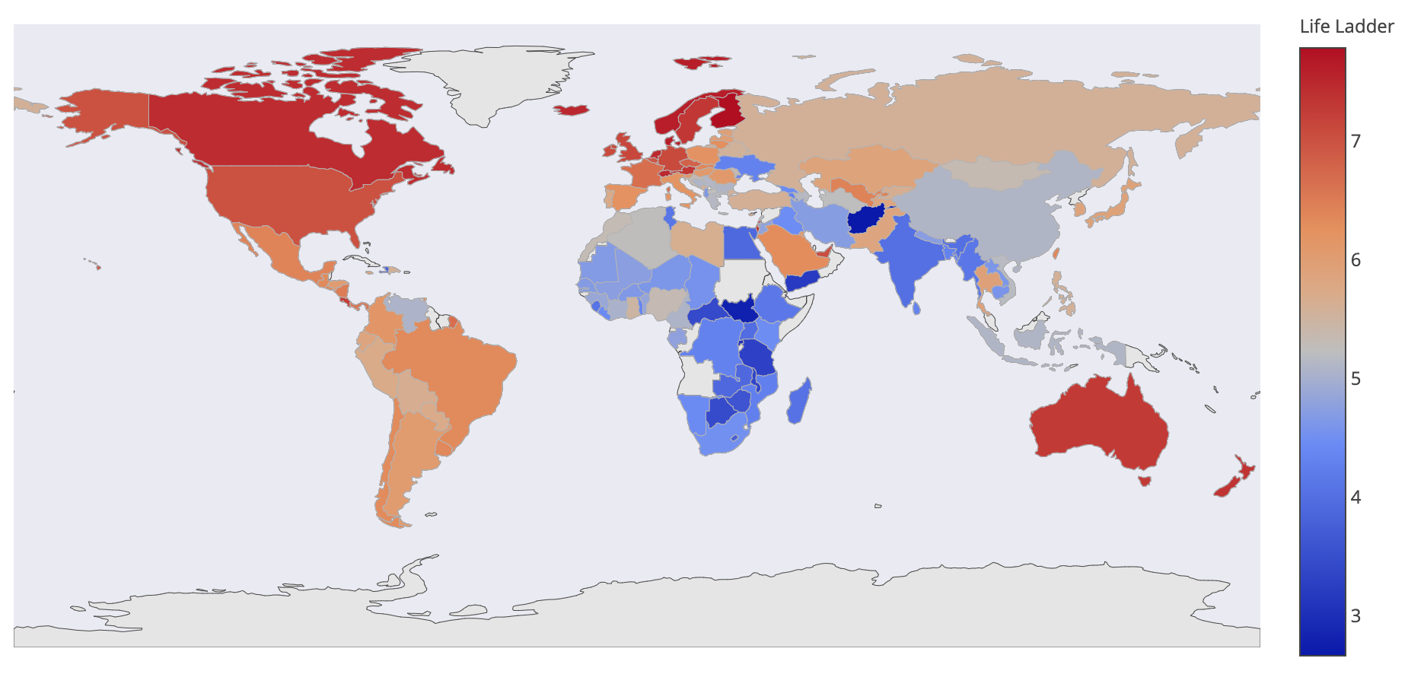
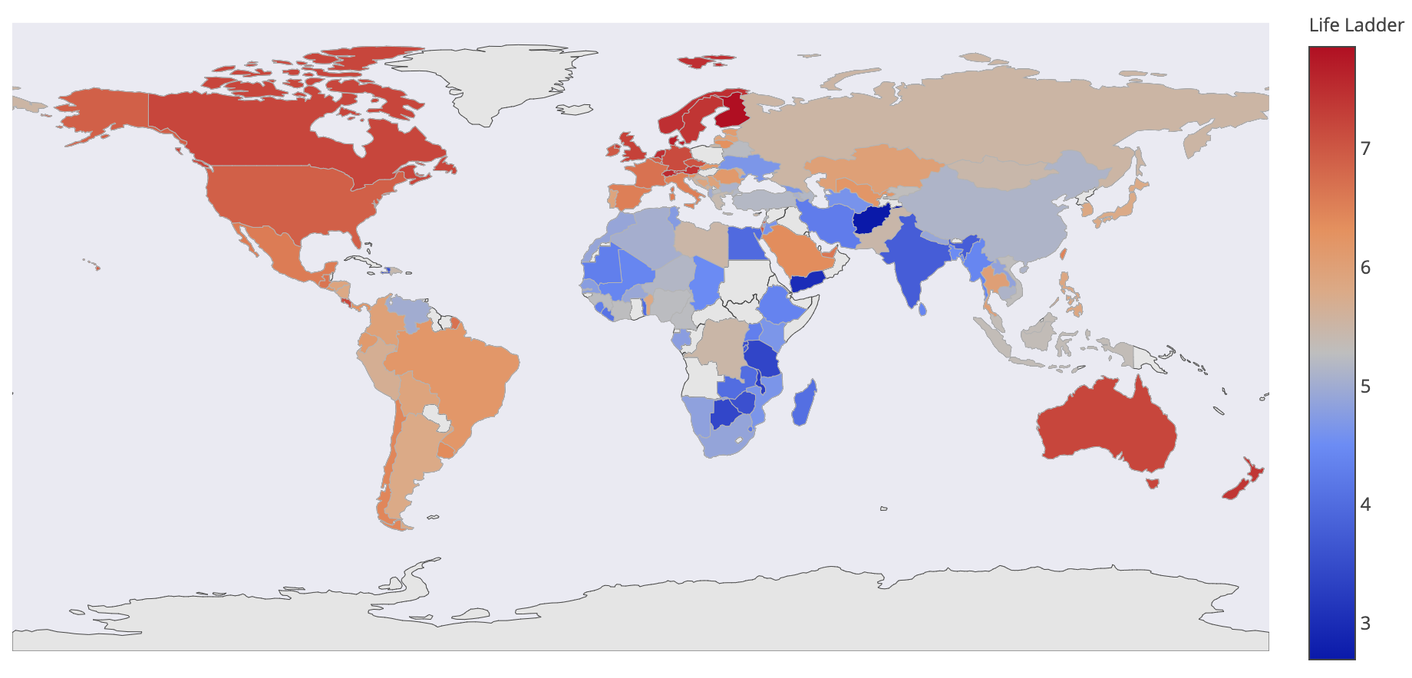
Now, let’s take a look at our…
Visualization
2005
2006
2007
2016
2017
2018
Background
Analysis
Prediction
Outcome
Conclusion

Slide 4
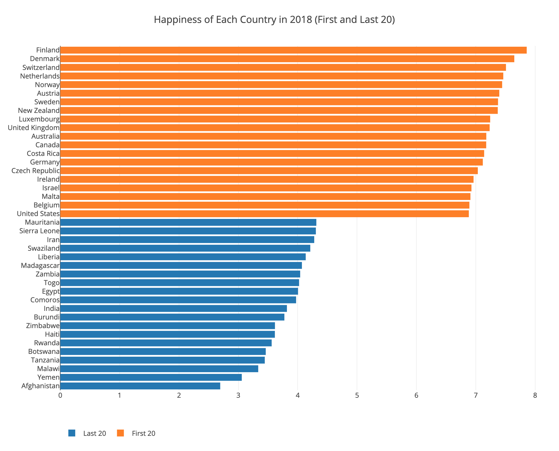
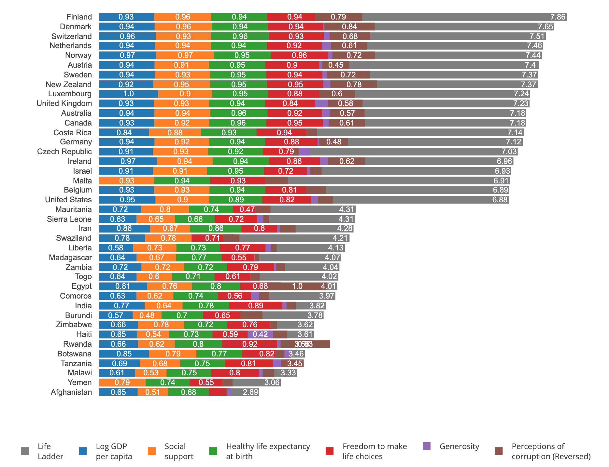
Now, let’s take a look at our…
Visualization
Countries' Happiness Scores in 2018 (First and Last 20)
Breakdown of Countries' Happiness Scores in 2018 (First and Last 20)
Background
Analysis
Prediction
Outcome
Conclusion

Slide 5
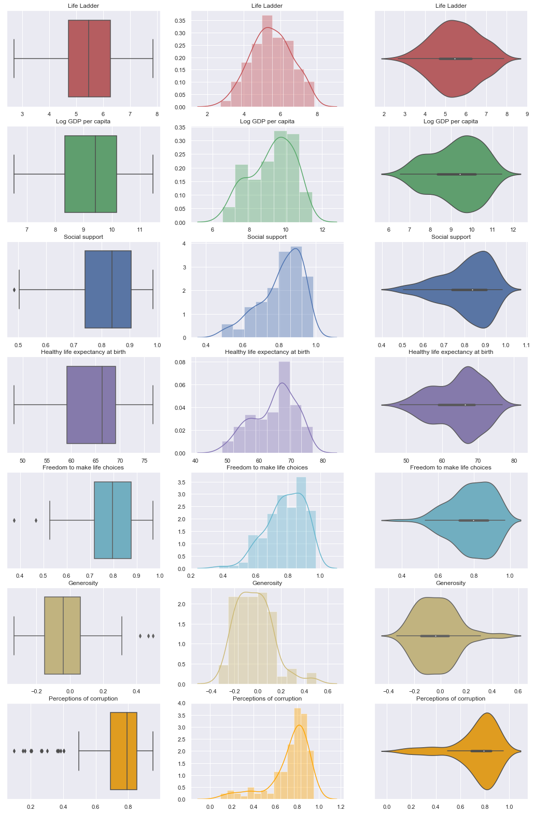
Now, let’s take a look at our…
Visualization
Background
Analysis
Prediction
Outcome
Conclusion

Slide 6
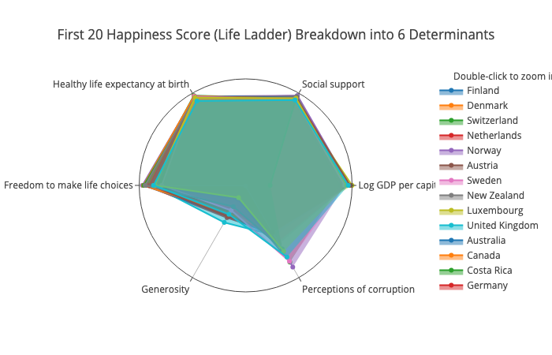
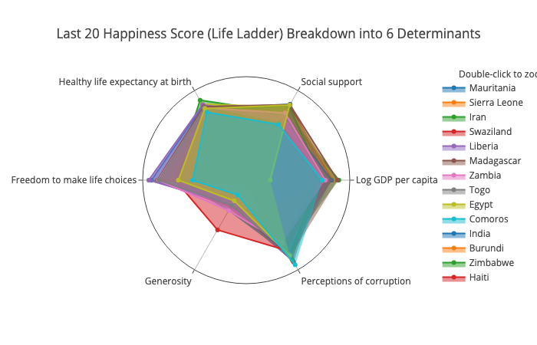
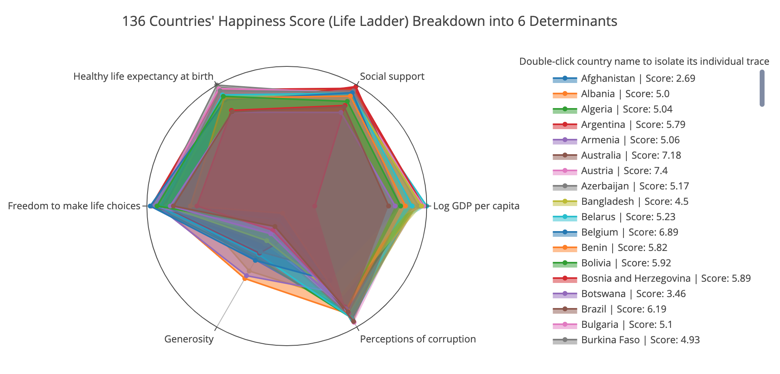
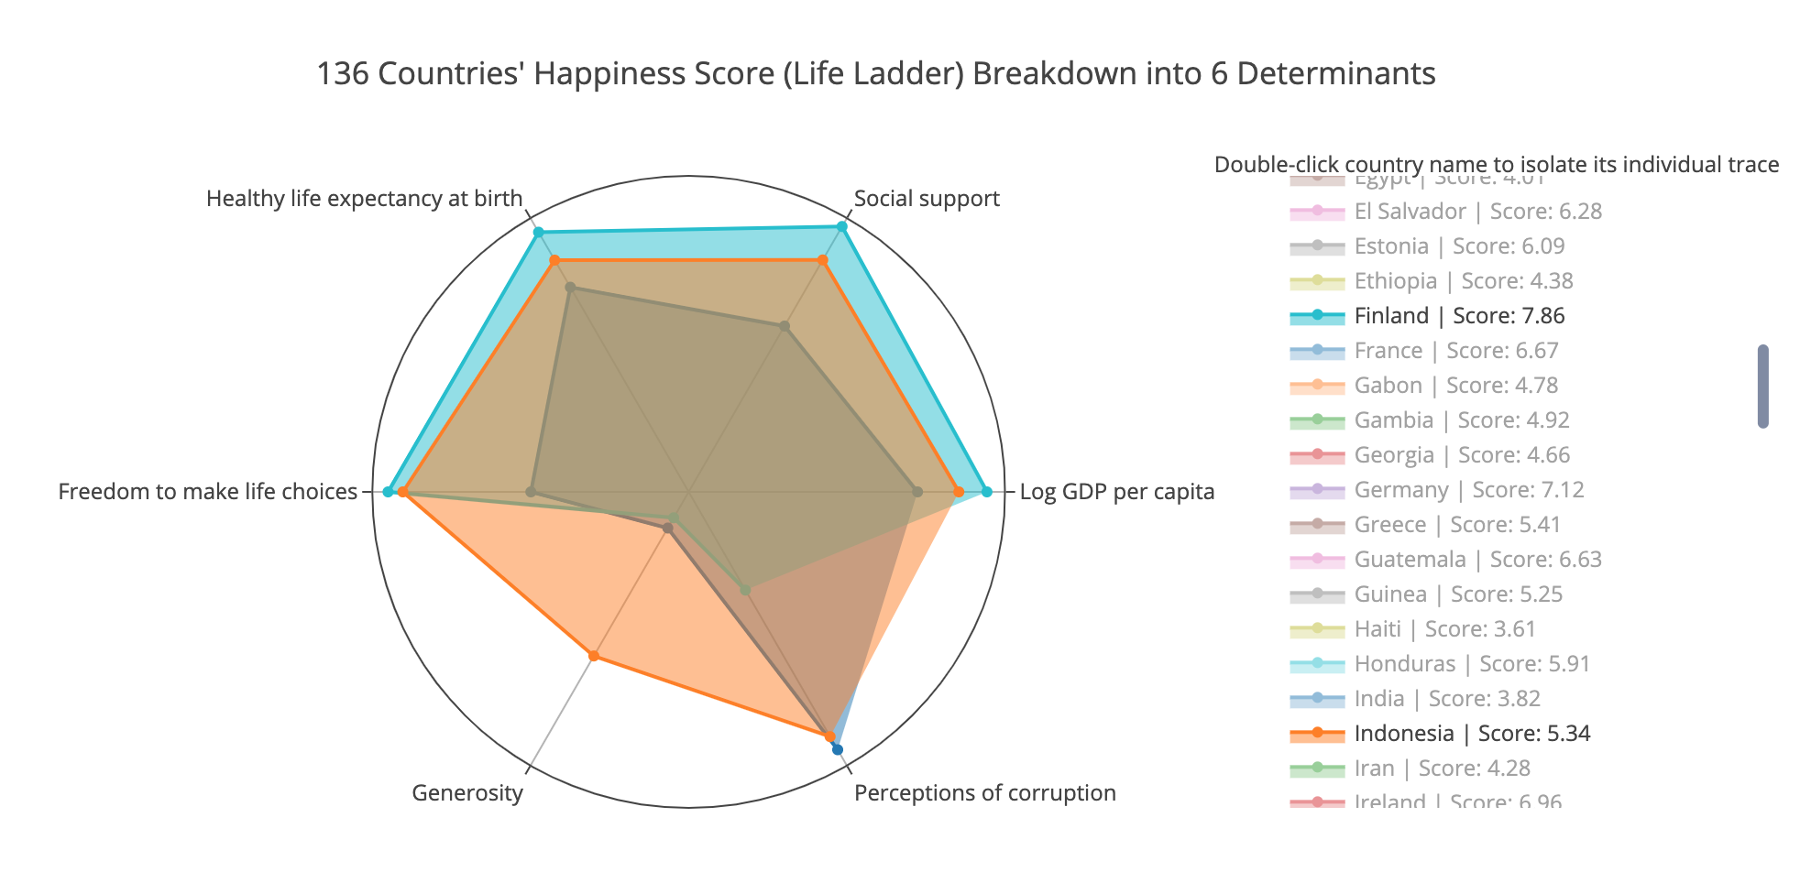
Now, let’s take a look at our…
Visualization
First 20 Happiness Score (Life Ladder) Breakdown into 6 Determinants
Last 20 Happiness Score (Life Ladder) Breakdown into 6 Determinants
136 Countries' Happiness Score (Life Ladder) Breakdown into 6 Determinants
Comparing Happiest, Unhappiest, and Most Generous Countries
Background
Analysis
Prediction
Outcome
Conclusion

Slide 7
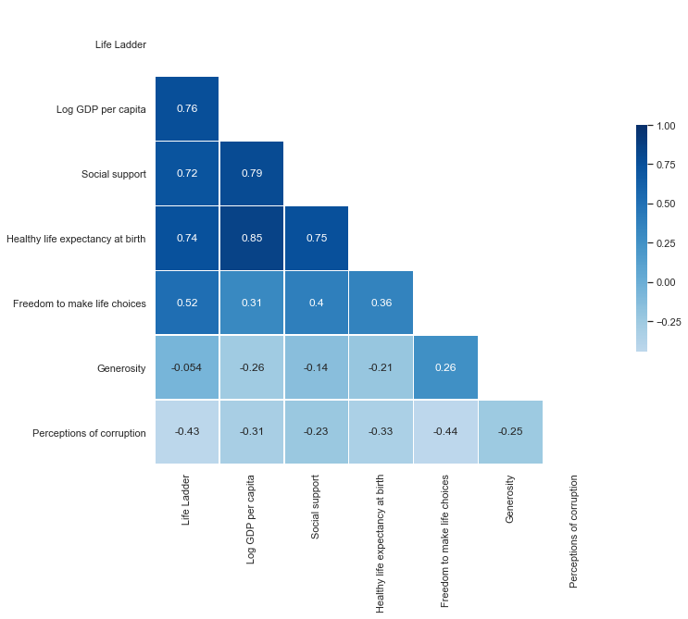
Now, let’s take a look at our…
Visualization
Background
Analysis
Prediction
Outcome
Conclusion

Slide 8
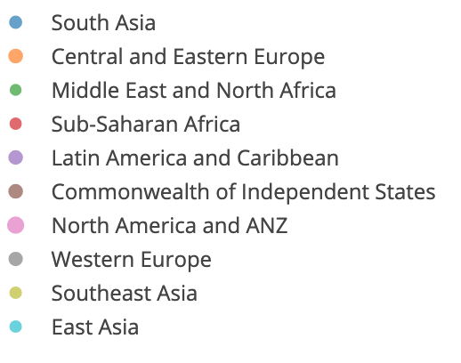
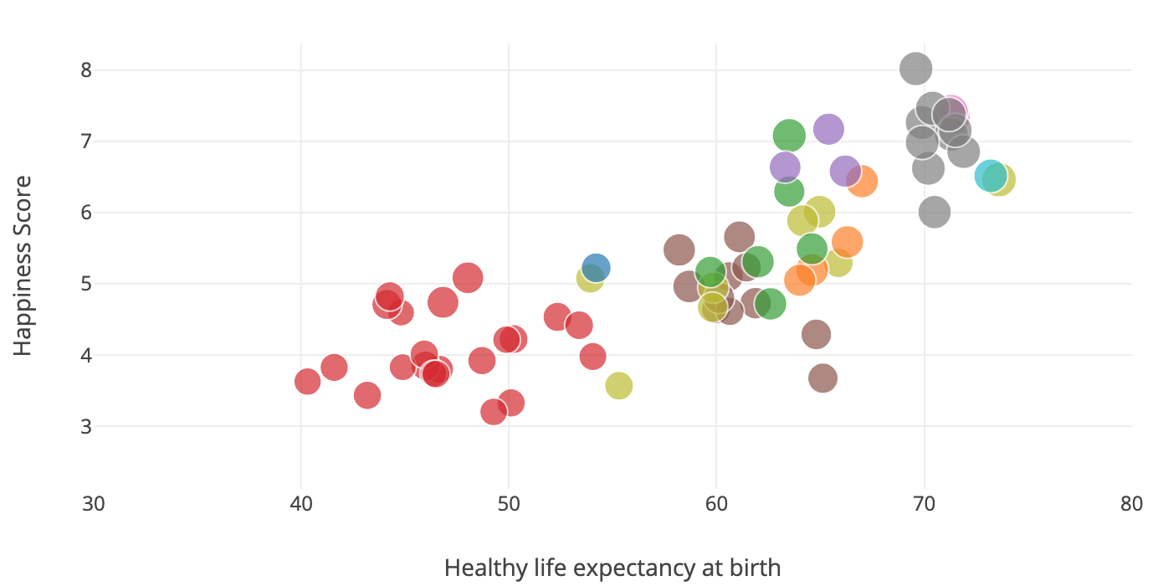
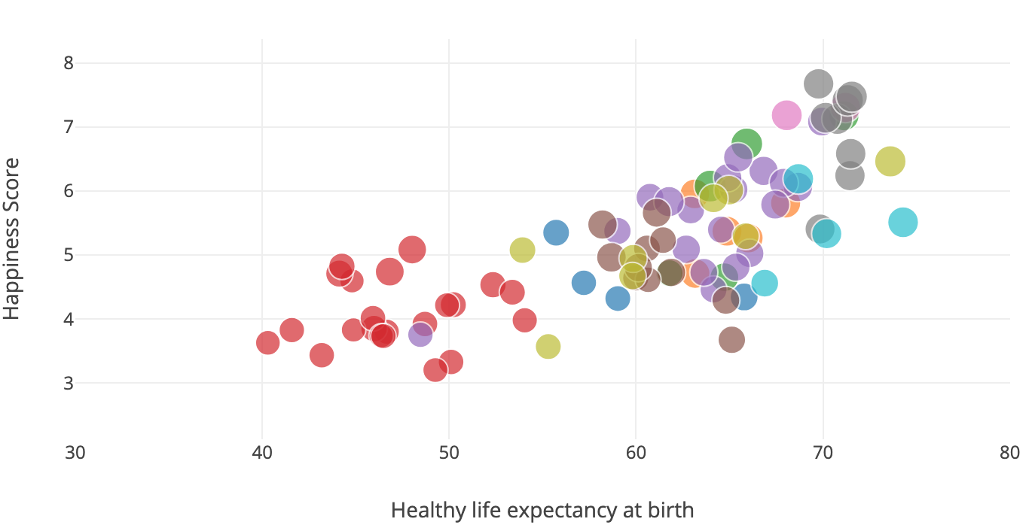
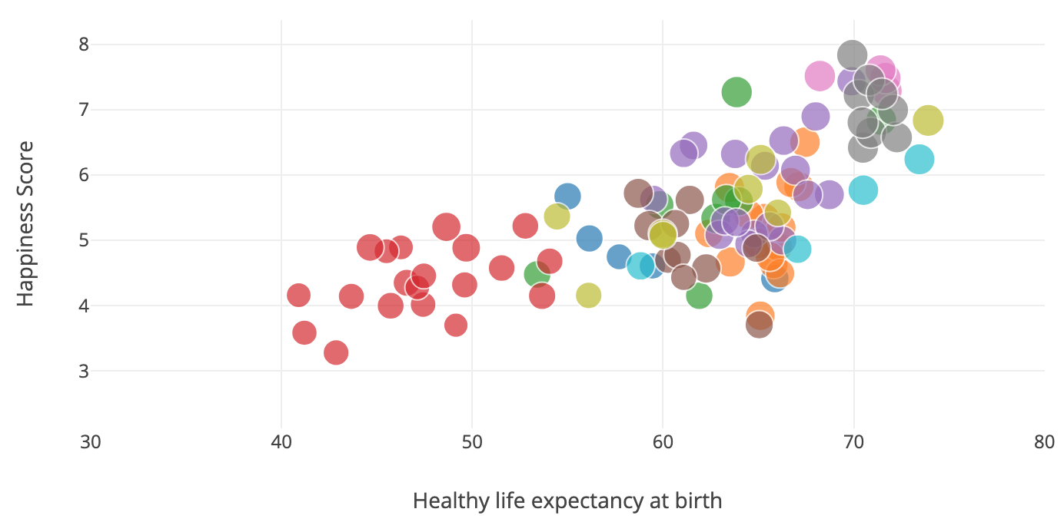
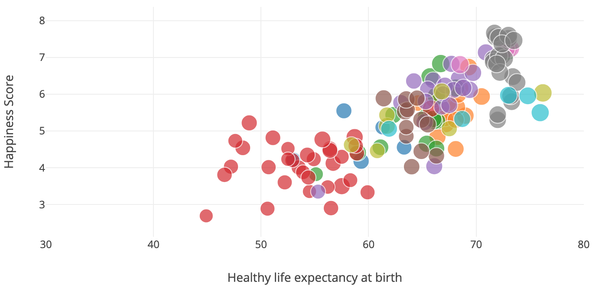
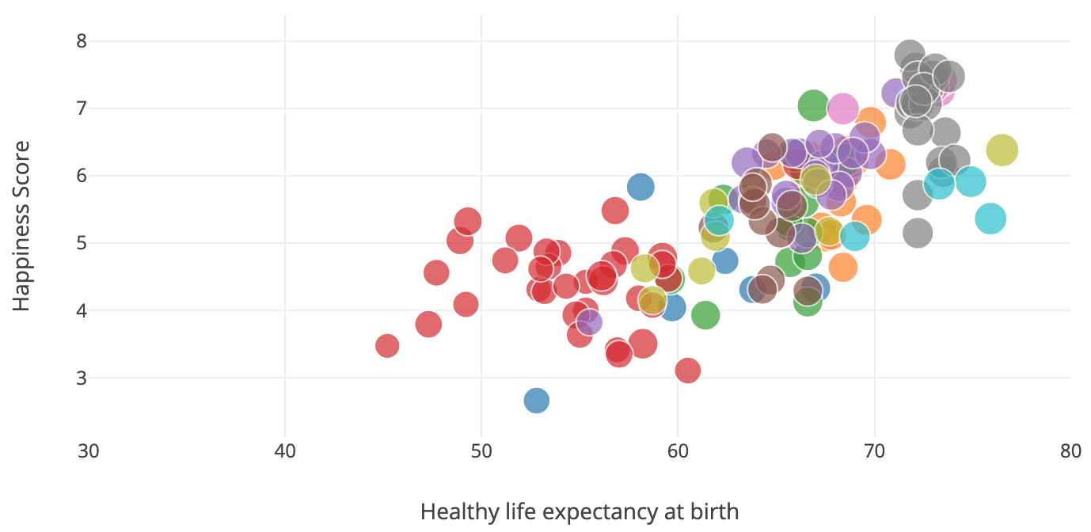
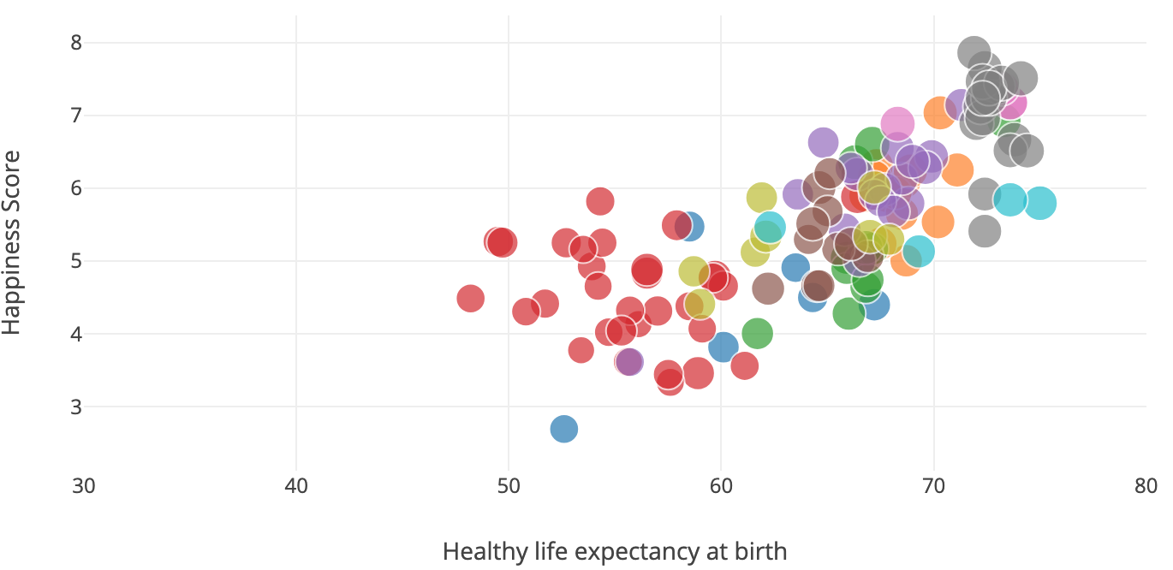
Now, let’s take a look at our…
Visualization
2005
2006
2007
2016
2017
2018
Background
Analysis
Prediction
Outcome
Conclusion

Slide 9
Now, let’s take a look at our…
Prediction
Predict each index for each country
Use the predicted indexes to predict happiness
Background
Visualization
Analysis
Outcome
Conclusion
Notes:
Then I will talk about prediction. Our prediction of happiness can be divided into two parts, predict indexes for each country and use the predicted indexes to predict respective happiness.

Slide 10
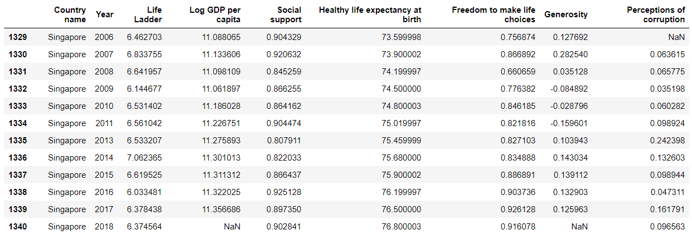
Now, let’s take a look at our…
Prediction
uni-variate linear regression for each column index
Predictions:
Background
Visualization
Analysis
Outcome
Conclusion
Notes:
Set Singapore as an example here and use uni-variate linear regression between each column index and year. Then the predictions can be obtained.

Slide 11
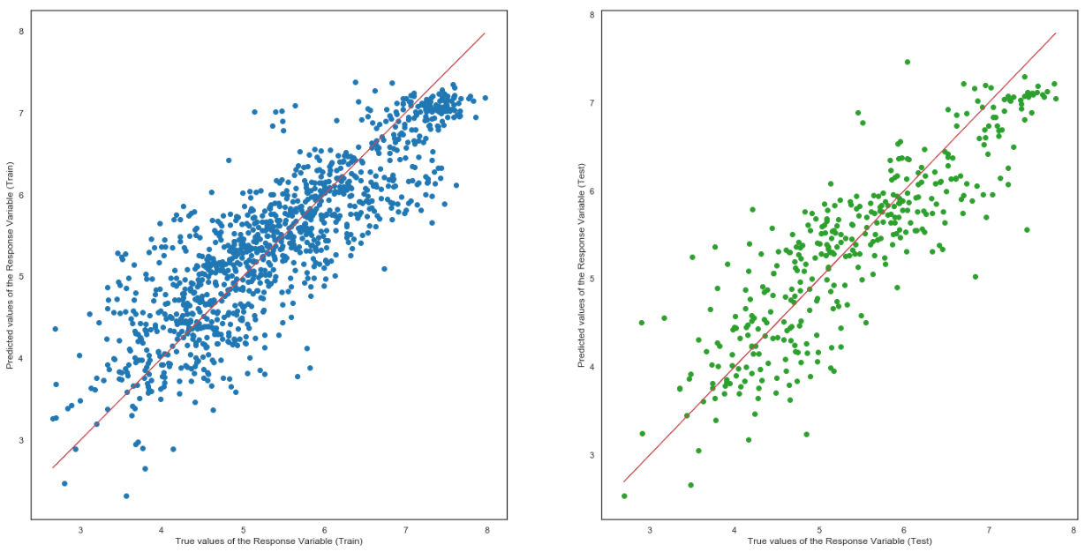
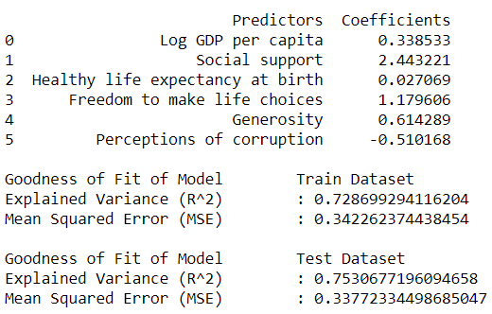
Prediction
√ after predicting the indexes for each country...
Predict happiness for each country by using all 6 indexes
Multi-variate Linear Regression
Background
Visualization
Analysis
Outcome
Conclusion
Notes:
After solving the first part, we remain to solve the second part. We have tried multi-variate linear regression for all indexes to predict happiness. However, seen from the R square value and MSE, the regression model is not so appropriate.

Slide 12
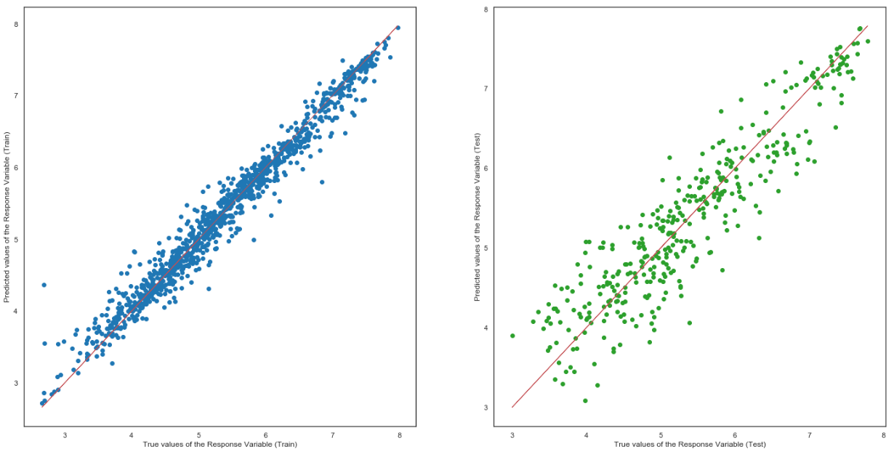
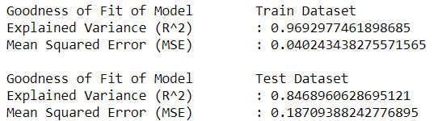
Prediction
Random Forest Regression
Background
Visualization
Analysis
Outcome
Conclusion
Notes:
Hence, we apply another sklearn module – Random Tree Regressor. By comparing the train and test plot between the two regression models, obviously random tree regression fits better for the train and test data, and R square value are relatively large and MSE are less.

Slide 13
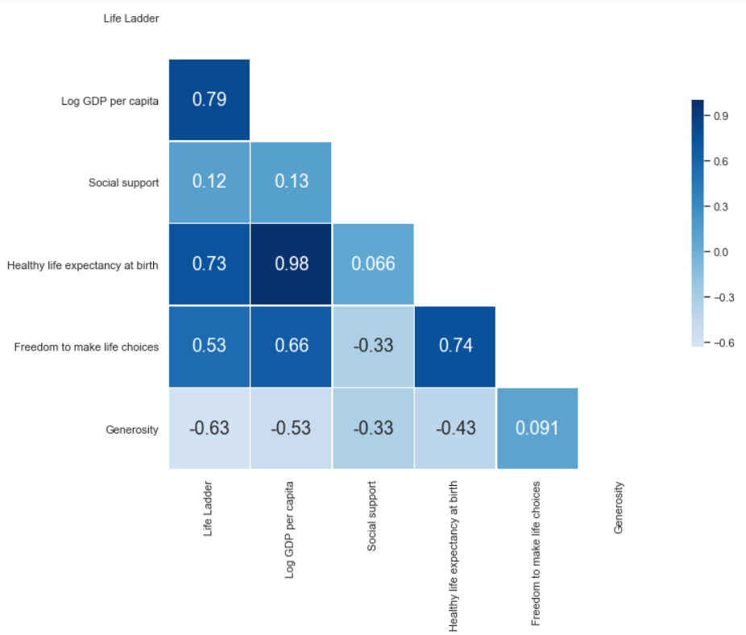
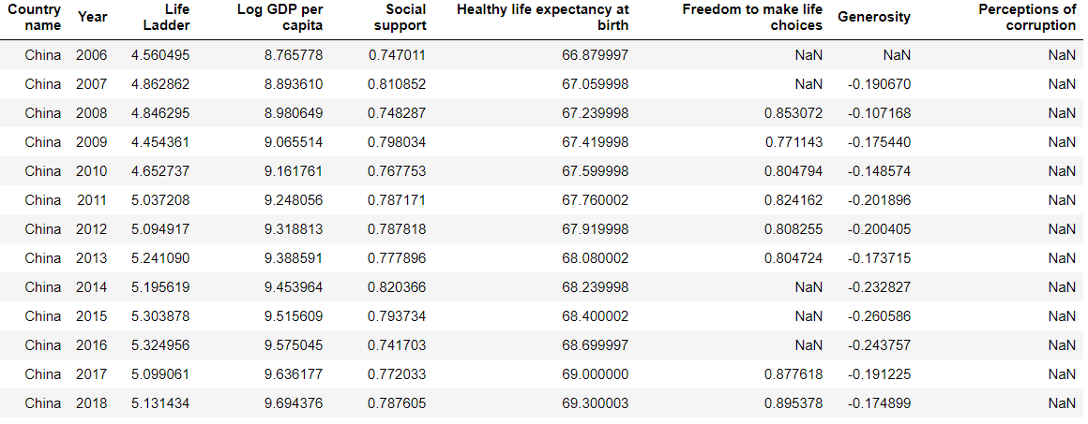
Prediction
Highest Correlation
Regression is great enough, but stats are not so ideal...
Uni-variate Linear Regression
Background
Visualization
Analysis
Outcome
Conclusion
Notes:
But for some statistics will contain a column of NA or more, for example, China, which does not have the perception of corruption value. Hence use an alternative way, to get the heatmap of indexes of each country, and find the highest correlation between life ladder and the respective index, hence use that index, which is GDP, to make uni-variate regression to predict life ladder, which somehow makes the prediction accurate.

Slide 14
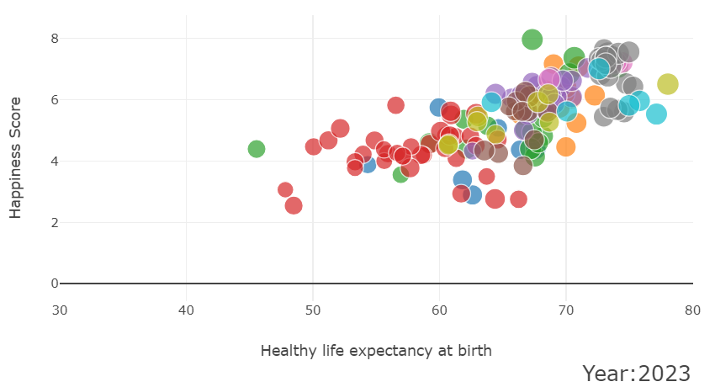
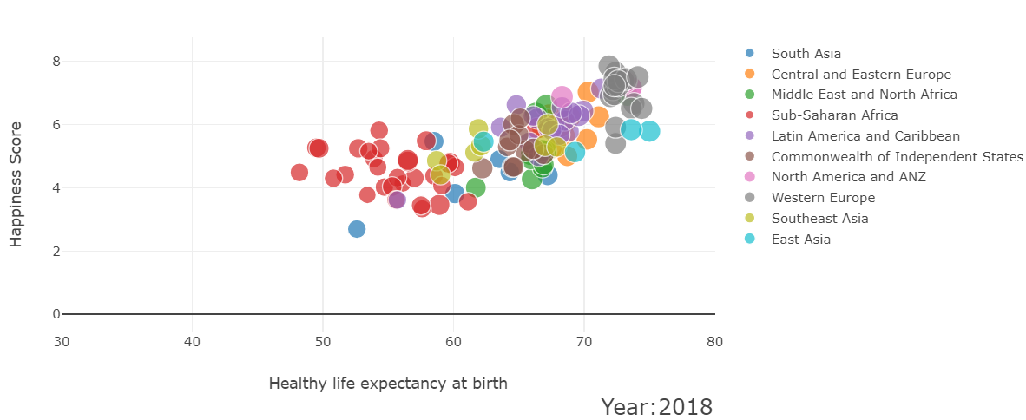
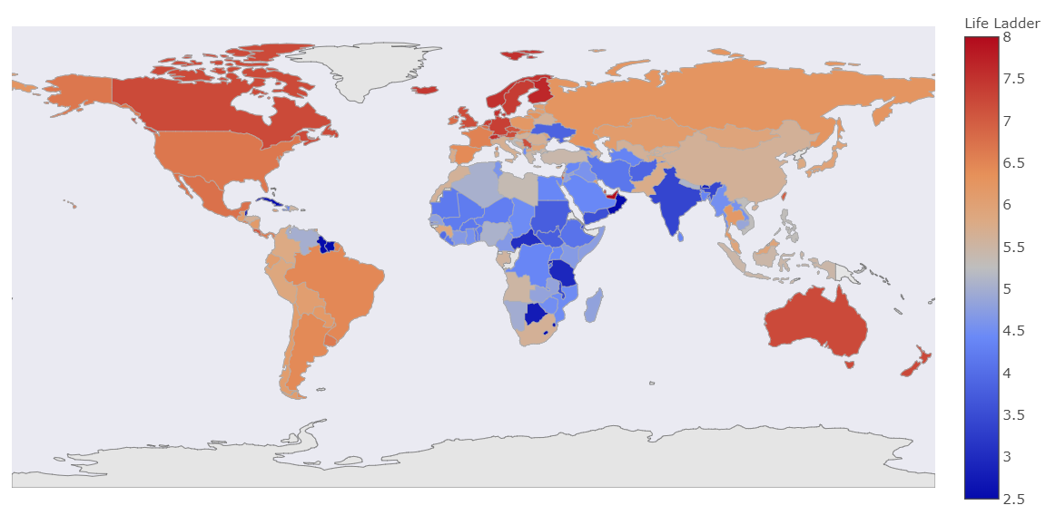
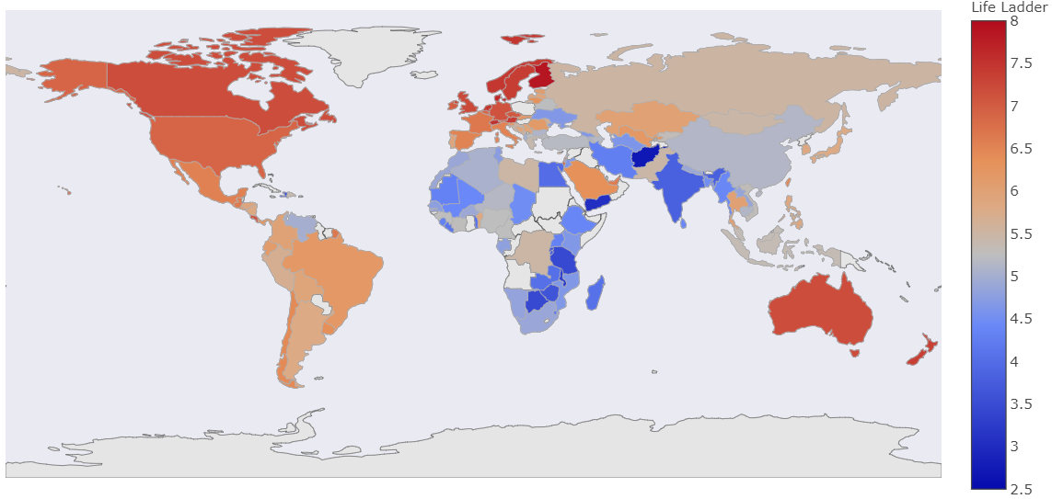
Prediction
World Happiness - Year 2018
World Happiness - Year 2023
Background
Visualization
Analysis
Outcome
Conclusion
Notes:
And here’s some predict results, we compare 2018 data and 2023 predicted data. The world map shows that large parts of the countries are becoming happier. Specially, North, South America, Europe, Australia, large parts of Asia stay high happy level or become happier. Typically, south Africa shows a slight decrease on happiness level. For the bubble plot, although data in 2023 are more deviated than data in 2018, the region happiness distribution between life ladder and life expectancy does not change significantly.

Slide 15
So, what is our…
Outcome
Did we achieve our objective?
Yes
Anything interesting ?
Visualization
Regression model.
Background
Visualization
Analysis
Prediction
Conclusion
Notes:
Did we achieve our objective
YEAH. WE TRIED DIFFERENT MODELS TO HELP WITH OUR PRIDICTION. EVENTUALLY, WE ARE ABLE TO IMPLMENT A MODEL THAT PRIDICT PROMISING RESULT. AS MENTIONED BY XIAO YANG WHICH IS THE RANDOM FOREST.
Anything interesting
AS MENTIONED KEANE UNDER THE VISUALLISATION
WE OBSERVED THAT THE TOP 20 CORRUPTION ARE PRETTY LOW
BOTTOM 20 CORRUPTION ARE PRETTY HIGH.
Radar CHART WE OBSERVED THAT THE generosity and corruption has a low core relation with the life ladder
Lastly we observe that countries are getting more and more unhappiness and live shorter over the year when we tried using the multivariances regression to predict.

Slide 16
Finally, for our…
Conclusion
Learning points
Ploty
More efficient in python code.
Challenges
Data cleaning
Background
Visualization
Analysis
Prediction
Outcome
Notes:
Learning points :
We learn potly,
We become more efficient in python code.
Challenge
Data cleaning
To conclude we believe we have a brighter future in term of better GDP and life expectancy

Slide 17
Thanks for tuning in! Any Question?
Random data

